Slide 1
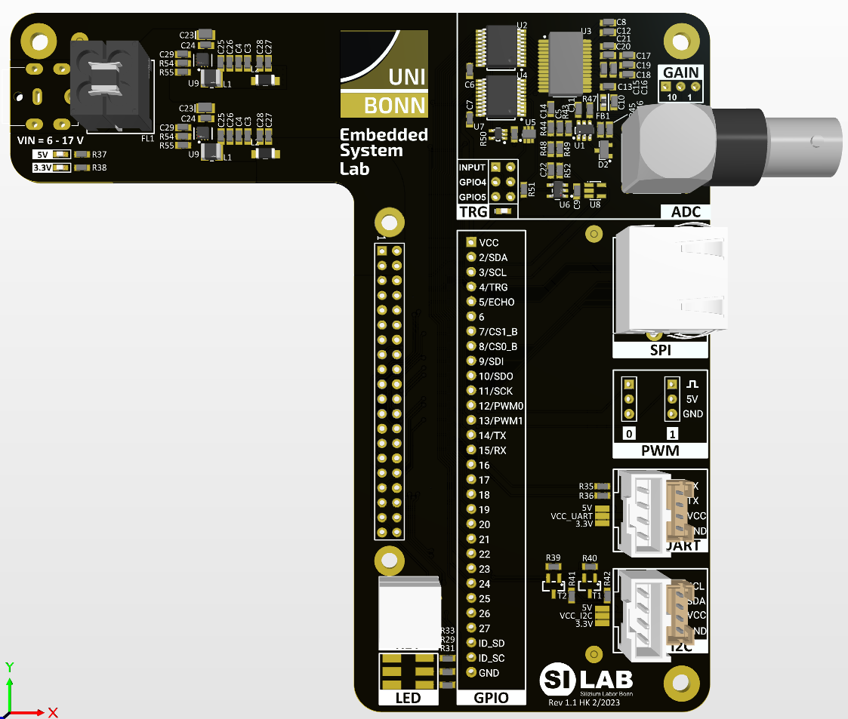
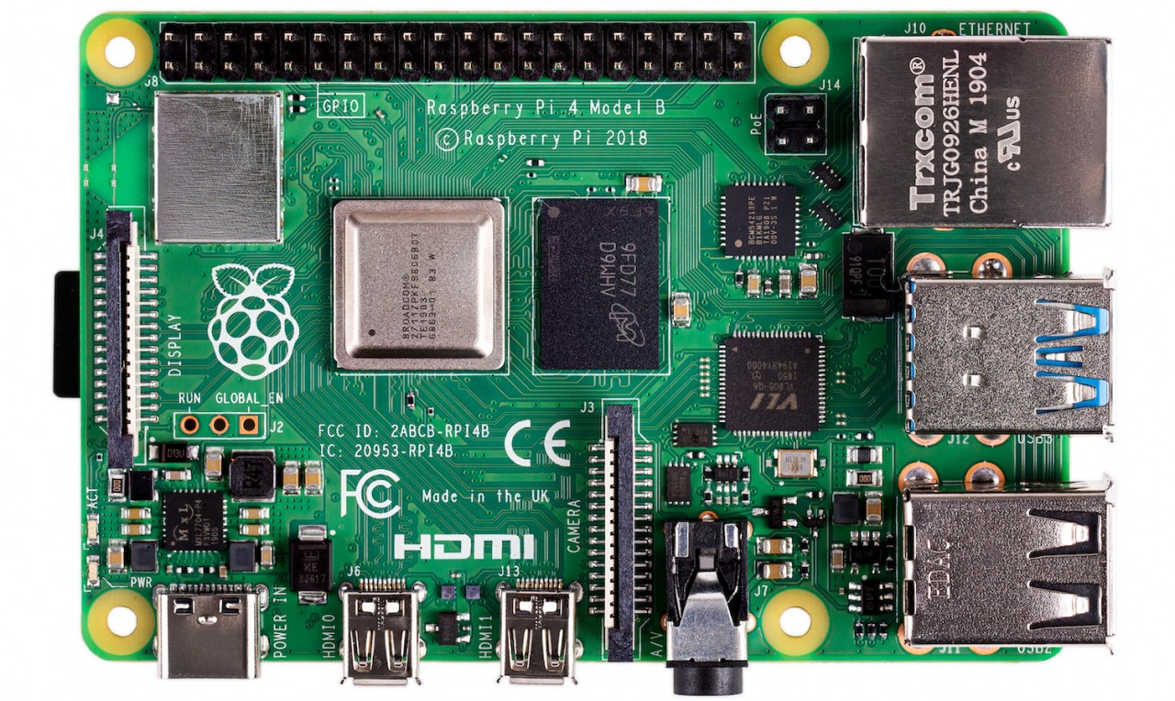

Slide 2
GPIO
LAN
WLANBT
SOC
SDRAM
ETH
USB
USB
AUDIO
USB
PWR
HDMI 0
HDMI 1

Slide 3
SDRAM
HDMI Ports
Broadcom BCM2711
ARM Cortex A-72
VideoCore VI
Core
Core
Core
Core
GPU
SDRAM Controller
Video Enc/Dec
Camera Interface
Display Interface
L1
L1
L1
L1
L2 Cache
L2 Cache
Mailbox
DMA
Debug
MMU
VC/ARM MMU
MMU
AMBA / AXI-Bus
PCIe
Ethernet MAC
USB 2.0
Timer
SDIO
UART
SPI
I2C
I2S / PCM
PWM
GPIO-Multiplexer
USB 3.0 Bridge
ETH PHY
SD Card
WiFi BLE
GPIO Connector
CPU
USB 3.0/2.0
RJ-45
USB-C
OTG
GPU/VPU
System Bus
Peripherals
External Components

Slide 4
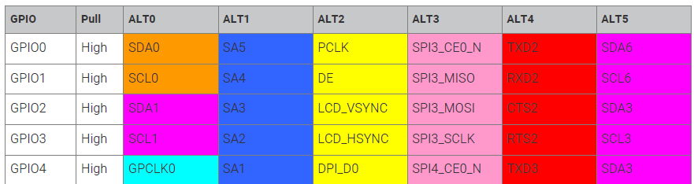
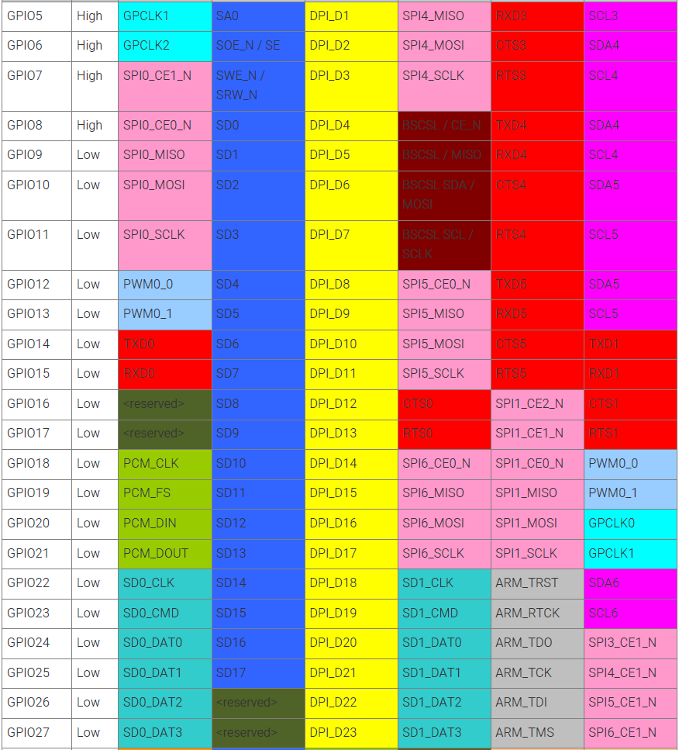

Slide 5
ARM / VideoCore Address Mapping (32-bit, Rpi 2/3, 1 GB RAM)
0xFFFF_FFFF
I/O Peripherals
Kernel Mode Address Space
SDRAM
(for VC)
0x3FFF_FFFF
SDRAM
(for CPU)
I/O Peripherals
PHYS_REG_BASE = 0x3F00_0000
I/O Peripherals
User/Kernel split set by kernel configuration
direct
SDRAM
SDRAM
(for VC)
0xC000_0000
VPU/CPU RAM split set by platform configuration
0XC000_0000
SDRAM
(for CPU)
I/O Peripherals
L2 cache
SDRAM
0x8000_0000
L2 cache non-alloc.
I/O Peripherals
BUS_REG_BASE
= 0x7E00_0000
User Mode Address Space
SDRAM
0x4000_0000
L1 + L2 cache
I/O Peripherals
VC/ARM MMU
ARM MMU
SDRAM
0x0000_0000
VideoCore Bus Address Space
CPU Physical Address Space
CPU Virtual Address Space

Slide 6
GPFSELn
Output Enable
GPSET/CLRn
Alternate Function Output
Driver
GPIO Mux
GPIO pin n
GPLEVn
Alternate Function Input
Receiver

Slide 7
3
Embedded
System
Lab

Slide 8
ACK
START
STOP

Slide 9
VDD
RX
RX
SDA or SCL
TX_B
TX_B
Master
Slave

Slide 10
TX
TX
RX
RX
UART
SDA
SDA
SCL
SCL
Master
I2C
Slave
SDA
SCL
Slave
MOSI
MOSI
MOSI
MISO
MISO
MISO
SCLK
SCLK
SCLK
CS_B
CS_B
CS_B
Master
SPI
Slave
Slave

Slide 11
LD
N-bit data latch
MOSI
D
Q
MISO
CS_B
CE
N-bit shift register
SCLK
>

Slide 12
Charge Sensitive Amplifier
Pulse Shaping Amplifier
Comparator
Dig. Logic
R_{F}
C_{F}
CSA_IN
CSA_OUT
SHA_OUT
-
+
COMP
HIT
C_{AC}
C_{HP}
R_{LP}
VTHR
-
CPLD
C_{INJ}
R_{HP}
C_{LP}
VINJ
τ = f(R)
>
DAC
INJ
SPI

Slide 13
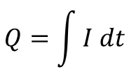
I_{SIG}
$$Q=\int{I dt}$$
U_{CSA}
U_{SHA}
U_{COMP}
V_{THR}
t
t
τ
t
t
CSA
SHA
COMP
Detector capacitance C_{DET}
Signal charge Q_{SIG}
Shaping time τ
Threshold V_{THR}

Slide 14
p_{HIT}
100%
50%
0%
Q_{THR}
Q_{INJ}

Slide 15
VIN
+
-
COMP_OUT
SAMPLE
SPI
DAC

Slide 16
2R
R
R
R
VDAC
2R
2R
2R
2R
VREF
D0
D1
D2
D3

Slide 17
VIN
+
-
COMP_OUT
SAMPLE
2R
R
R
VDAC
…
2R
2R
2R
2R
VREF
…
D0
D1
D6
D7
SPI
8-bit shift register

Slide 18
V_{ISNS}
ADC
+
-
I2C
V_{DAC}
R_{SNS}
G = 10
DAC
+
-
V_{OUT}

Slide 19
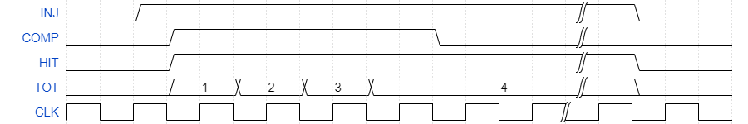
COMP
S
Q
HIT
R
Q[7:0]
TOT[7:0]
D[7:0]
CE
CLK
R
CE
Q
MISO
INJ
8-bit counter
8-bit shift register
CS_B
SCLK
Injection (INJ → high)
Reset (INJ → low)

Slide 20
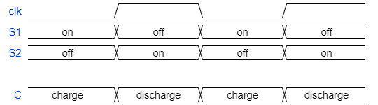
S1
I_{avg}
CLK
S2
=
CLK
V₀
C
V₀
V_{bias}
R_{lpf}
C_{lpf}
R_{bias}
CLK
C_{ac}
C_{det}

